Slide 1


Flask Session identity forgery
The SECRET_KEY and SSTI vulnerability
Name: Kaiwen, Luo ( Kevin )
Student ID: z5100899
Presentation Date: 17.04.2019
Tutor: Ka Wing Ho

Slide 2
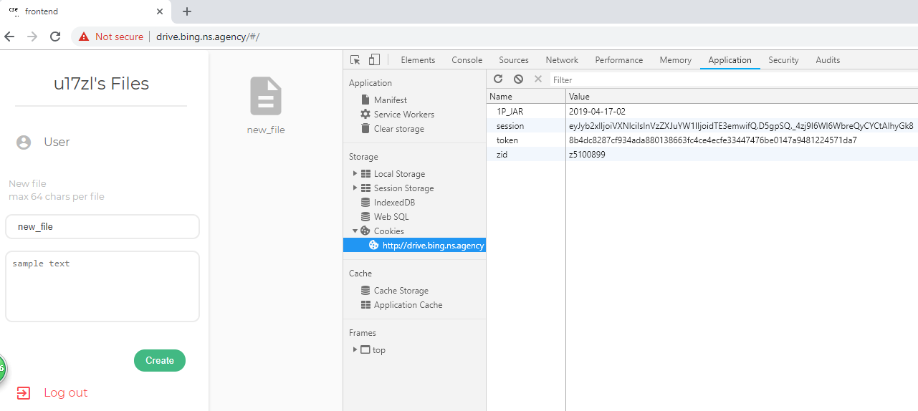
Something Interesting

Slide 3
Something Interesting

Slide 4
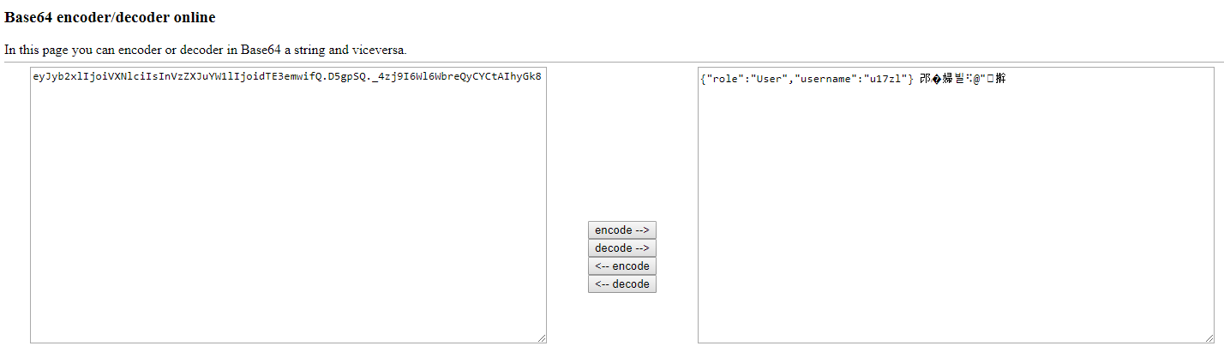
Something Interesting

Slide 5
Something Interesting
？admin

Slide 6

Flask
Session
Set Cookie
Indentification
Notes:
Flask is a session that exists on the client side and is encoded by Base64 and signed by key. Although there is no signature and session can not be forged, there is a lot of information that can be directly decoded from session.

Slide 7
Flask
SECRET_KEY
Session
Set Cookie
Indentification
Notes:
Flask is a session that exists on the client side and is encoded by Base64 and signed by key. Although there is no signature and session can not be forged, there is a lot of information that can be directly decoded from session.

Slide 8
SSTI
Notes:
Flask is a session that exists on the client side and is encoded by Base64 and signed by key. Although there is no signature and session can not be forged, there is a lot of information that can be directly decoded from session.

Slide 9
SSTI
Server-side template injection(SSTI) occurs when user input is unsafely embedded into a server-side template, allowing users to inject template directives. Using malicious template directives, an attacker may be able to execute arbitrary code and take full control of the web server.
Notes:
Flask is a session that exists on the client side and is encoded by Base64 and signed by key. Although there is no signature and session can not be forged, there is a lot of information that can be directly decoded from session.

Slide 10
SSTI
How does it work?
http://127.0.0.1:8999/content/?content={{'hello,world'}}
Notes:
Flask is a session that exists on the client side and is encoded by Base64 and signed by key. Although there is no signature and session can not be forged, there is a lot of information that can be directly decoded from session.

Slide 11
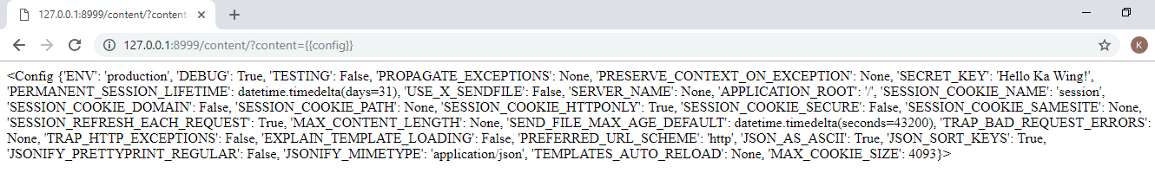
SSTI
How does it work?
http://127.0.0.1:8999/content/?content={{config}}
Notes:
Flask is a session that exists on the client side and is encoded by Base64 and signed by key. Although there is no signature and session can not be forged, there is a lot of information that can be directly decoded from session.

Slide 12
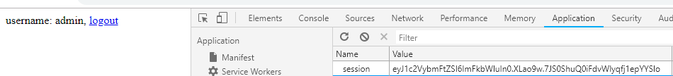
Forge the admin session
https://github.com/noraj/flask-session-cookie-manager
Notes:
Flask is a session that exists on the client side and is encoded by Base64 and signed by key. Although there is no signature and session can not be forged, there is a lot of information that can be directly decoded from session.

Slide 13
Forge the admin session
DONE!
https://github.com/noraj/flask-session-cookie-manager
Notes:
Flask is a session that exists on the client side and is encoded by Base64 and signed by key. Although there is no signature and session can not be forged, there is a lot of information that can be directly decoded from session.

Slide 14
Thank u!
Notes:
Flask is a session that exists on the client side and is encoded by Base64 and signed by key. Although there is no signature and session can not be forged, there is a lot of information that can be directly decoded from session.

